Slide 1

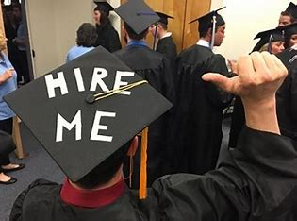
Job Market Skills Recruitment and HR
Mock Job Interview Practice
CV Writing Workshop
Action Verbs

Slide 2
Interactive Listening and Speaking Activity:
The Virtual Interview Practice Tool
With the help of a virtual interview practice tool, you will gain interview practice by listening to interview questions that you could be asked in real life interviews and practicing your answers.
Virtual Interview Practice tool | Barclays LifeSkills

Slide 3
Date | Lesson | Theme | Learning Outcomes/Objectives | Theme/Activities/Skills targeted | Resources
17/02/23 | 2 | Recruitment and HR | After completing this lesson students should be able to:- Finalise their CVs Identify and put into use the right action verbs in their CVs Answer typical interview questions | Teacher led discussion on Action Words to use in a CV Listening for detail: Mock Interviews whereby students answer interview questions | Action Verbs for Job Descriptions [The Comprehensive List] | Ongig Blog http://hrweb.berkeley.edu/sites/default/files/attachments/action-verbs.pdf Virtual Interview Practice tool | Barclays LifeSkills

Slide 4
What are actions verbs?
Action verbs convey doing—for example, “I Executed the software rollout to twelve departments within two months.” “Mentored four colleagues, two of whom were promoted within three years.”
On your resume, action verbs show readers you accomplished something at your past jobs, you weren’t just “responsible for” it. Instead you “streamlined” or “coordinated” or “executed” it. You got the job done and you achieved something in the process.

Slide 5
Some of the best words you can include in your resume, most of which are action verbs include but are not limited to:-
Achieved
Improved
Trained/mentored
Managed
Created
Resolved
Volunteered
Influenced
Increased/decreased
Negotiated
Launched

Slide 6
Links to Winning Resume Action Verbs
Action Verbs for Job Descriptions [The Comprehensive List] | Ongig Blog
http://hrweb.berkeley.edu/sites/default/files/attachments/action-verbs.pdf

Slide 7

Practice Makes Perfect
Go through the action verbs and polish your CV to make a winning final draft.

Slide 8

The End.
Thank you for your time

